Slide 1
Entrepreneurial Finance Screening Criteria
Professor Burnes
Leeds School of Business
University of Colorado at Boulder
Leeds
B U S I N E S S

Slide 2
Agenda
Screening Criteria for Ventures
Comparables
Multiples
Scorecard

Slide 3
Take Aways
Noting some of the questions/take aways from last week
“Buckets” of Value Drivers
Where to Find Value in Financial Statements/Pro Formas
Lenses to Apply to Credibility
Tools to Turn value driver buckets into $$

Slide 4
A few questions you brought up….
I want to know more about when or if they ever need to replace the CEO of the company they have invested in. I still think that is one of the craziest things they have the power to do and im curious of how VCs go about accepting that risk.
How do venture capital firms discover these companies, do they come to the company or does the company come to them? Additionally, I would be curious to know how much control a venture capital fund gains over a company after making an investment.
I would like to know more about how VCs approach or look at prospects that venture into completely new markets. Not a competitor in sight, something invented, not innovated. What do they do when they run into something like that? No market research to evaluate, which is what the majority of research comes from.

Slide 5
The Setting
New Venture
Need Capital
Seek VC Funding
Sector
Time
Revenue
Profitability
Why
When
How Much
How Long
Which One
Ownership
Reputation

Slide 6
Necessary Terms these are from the Income Statement
** | Revenue
- | COGS | Cost of Goods Sold (variable Cost)
 | Gross Profit
- | OPEX | Operating Expenses (Overhead – Fixed Costs)
** | EBITDA | Earnings Before Interest Taxes Depreciation and Amortization
**Multiples are typically based on either Revenue OR EBITDA

Slide 7
Buckets for Screening Criteria **these are guidelines but actual deals may require adaptation
Market
Financials
Team
Product
Size
Ownership
Competitors
Revenue
EBITDA
Cash Flow
5 year Pro Forma
Valuation
Founder
Sales
Operations
Finance
<Size>
Patent
Unique
Disruptive
New World
Risk
Assumptions
Other
Exit
Black Swan
Key Person
IP protection
Growth
Discount rate
Access
Exit
To Whom
When
Multiple (ROI)

Slide 8
How do we systematically collect data to put in these buckets.
Company | Fin Basis | Multiple | Bought by | WHEN
 | Pre Revenue Revenue EBITDA | Exit Value/Fin Basis | M&A PE IPO | Multiples and Deal Types change over time

Slide 9
Example: You are in the Food Products Industry (Manufacturing)
Some of your key descriptors include:
All-natural
Gluten free
Non-GMO
Your 2024 Revenue is $150M
Your EBITDA is $27M
?? What is your % profitability on an EBITDA basis?
= EBITDA/Revenue
Your revenue growth for past 3 years is:
2021 | 2022 | 2023
20% | 67% | 123%

Slide 10
If you were in the healthy foods space, you might consider the following…
Comparables | EBITDA | Multiple | Implied Valuation | Bought by | WHEN
Organic Nut Butter | $230M | 3X |  | PE | 2019
No Refined Sugar Chocolate | $20M | 5X |  | Public CompanyCPG | 2021
Kids’ Fruit Snack | $8M | 6X |  | Disney | 2020
Organic Mac & Cheese | $570M | 3.5X |  | Public Company CPG | 2022

Slide 11
Based on the table in Slide 10, where do you put your valuation? Why?
Discuss with your neighbors for ~ 5 minutes then let’s report out using terms from “the buckets”
please see spreadsheet ESBM4570_3.1.xlsx
Use the Comps tab

Slide 12
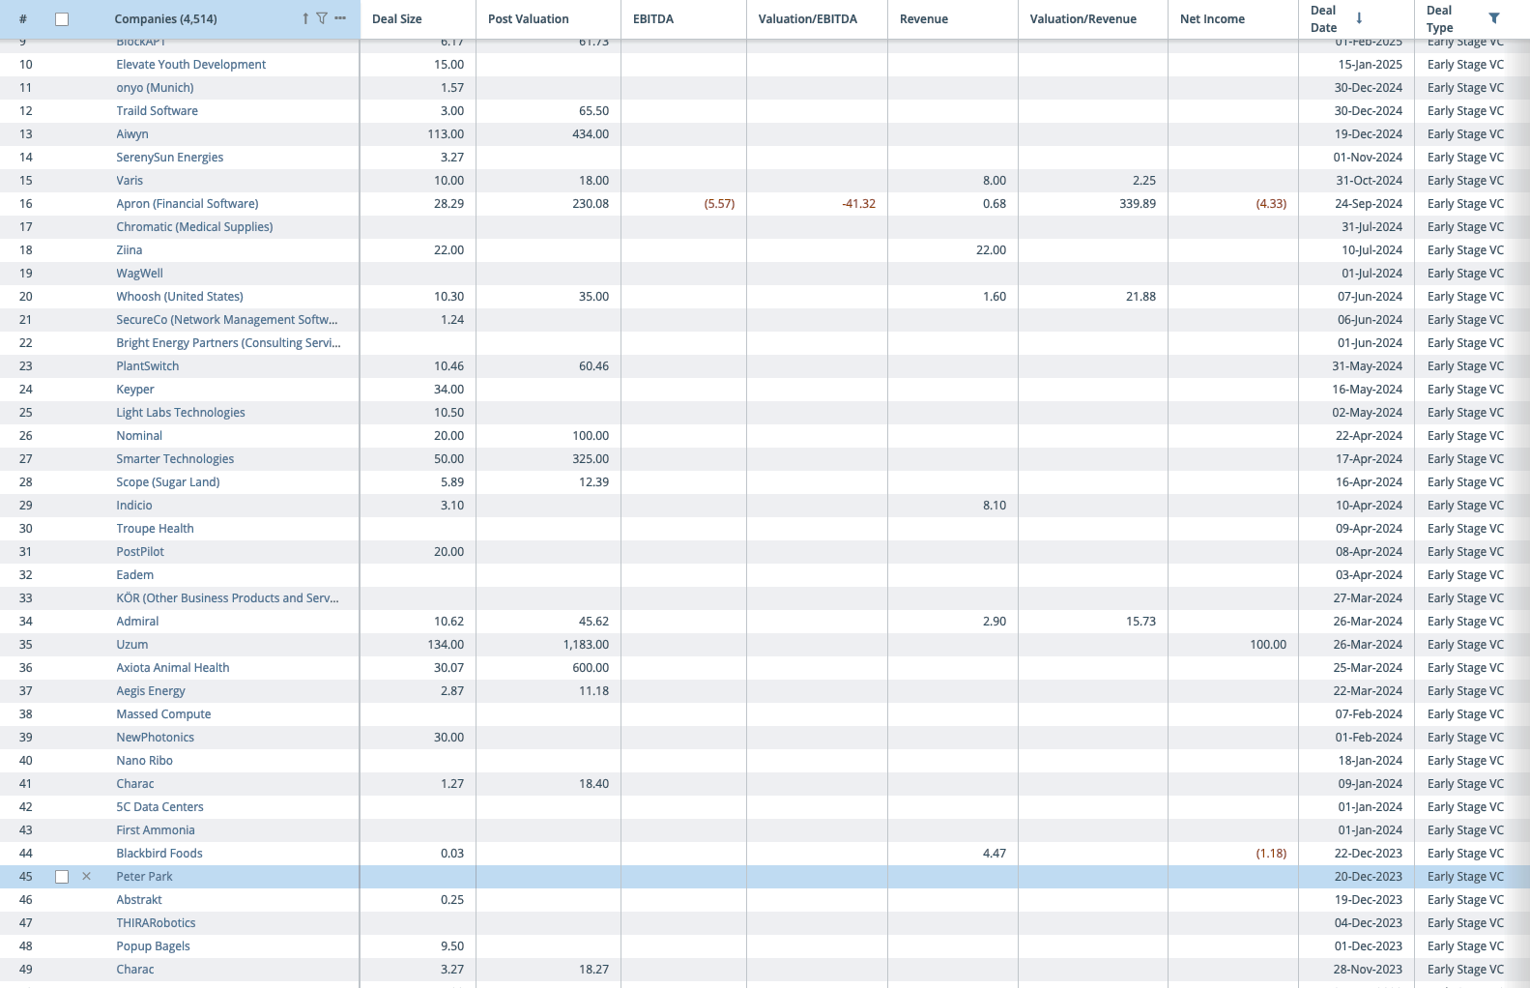
X

Slide 13
Decision and Next Steps: the Scorecard please see spreadsheet ESBM4570_3.1.xlsx
What are the key value drivers, and in which buckets do they Fall.
Validate for yourself: these categories and buckets represent my valuation criteria OR these categories and buckets represent my understanding of the investor’s valuation criteria
Under WEIGHT, assign the % of the deal value that each factor drives. The WEIGHTS must some to 1.
CAVEAT… this is where you check that you don’t have too many categories – you want your categories to MEANINGFUL in their contribution to value
Ranking is tricky. This is where you compare THIS deal to your comps and/or other deals. If you rank your company as 1, that means that your company is just like other companies on this criterion. If you rank your company as .5, your company is ½ as good as other companies.
Multiply WEIGHT*Ranking to get VALUE. For example,if a category has a weight of 5% toward deal success, and you are just like other companies, the value of this criterion is really small

Slide 14
Doing It
1) For the Valuation based on Comps, use =[link to Comps page and the valuation you calculated]
2) Weighted Scoreboard Multiplier =sum(category values)
If this is >1, your uniqueness in these “non financial” categories will increase your valuation.
If this is <1, your uniqueness in these “non financial” categories will decrease your valuation
3) Multiple the
Valuation Based on Comps x Weighted Scoreboard Multiplier
To get Scorecard Adjusted Valuation
Let’s Try It!

Slide 15
Tools
Comparables: Who Why
Other Exits: How, When Did your Comps Exit
Multiples: What was the “multiple on” [Revenue], EBITDA
Scorecard: How will a investor consider Financial, Team, Market and/or additional criteria to address your valuation

Slide 16
Wednesday
Introduction to Financial Statements and Ratios

Slide 17
Monday 9/15
Bobs Baloney
Pre Quiz
Post Case Take Aways

Slide 18
Side Note
We applied deal screening criteria to get to a Valuation.
There are multiple ways to approach Valuation – it is good to triangulate by using multiple approaches.
Ultimately, you will negotiate a Valuation
Valuation determines
How much you can raise
From WHOM you will raise company
Value per share of your company
% of company you will sell
Cost of Capital

